Slide 1
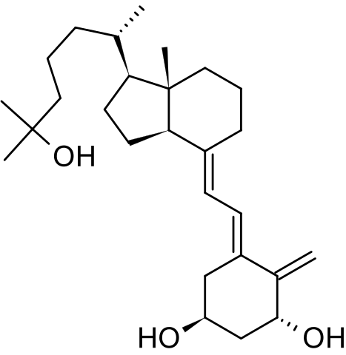
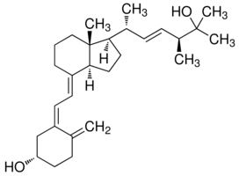
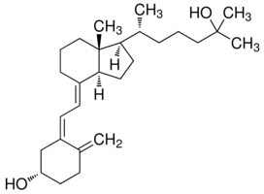
Clinical Diagnostics: 25-OH Vitamin D₂ & D₃ in Human Plasma
Application Note: VDKT10001
VITAMIN D METABOLITE EXTRACTION KIT
Compounds :
1,25-DOH Vitamin D₃ 25-OH Vitamin D₂ 25-OH Vitamin D₃
VITAMIN D KIT EXTRACTION METHOD:
(Vitamin D Metabolite Extraction kit: VDKT2C-30)
Automated Process using Oroflex Personal Pipettor
Step 3: Transfer sample the Plate
Reagent Reservoir
Internal Std Plate
Serum Sample Plate
VITAMIN D MET Extraction Plate
Station 4
Station 3
Station 2
Station 1
Pos. pressure processor
Step 2: Spike samples with Int. std.
and mix sample 3x.
Step1: transfer reagent to extraction plate
(total process time is less than 20 min)
LC-MS/MS ANALYSIS
RESULTS:
 | 1,25-dihydroxy VD₃ | 25-OH VD₂ | 25-OH VD₃
Recovery% | 68 | 69 | 77
CV% | 14 | 8 | 6

Slide 2
Phospholipid Profile for Serum Samples using Different Sample Preparation Products

